Slide 1
A Diversity-Promoting Objective Function for Neural Conversation Models
Jiwei Li
NAACL, 2016

Slide 2


Background

Slide 3
Outline
Seq2Seq basis for response generation
The “I don’t know” problem
MMI objective function
Evaluation and Results

Slide 4


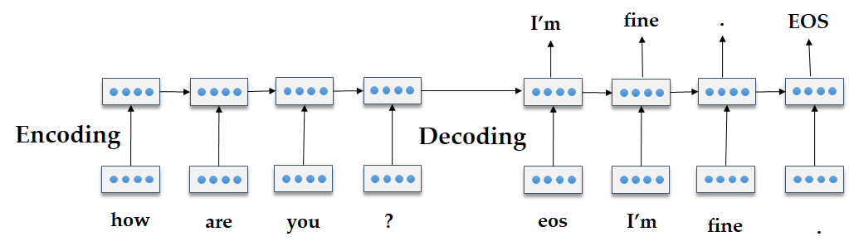
Seq2Seq Models for Response Generation

Slide 5
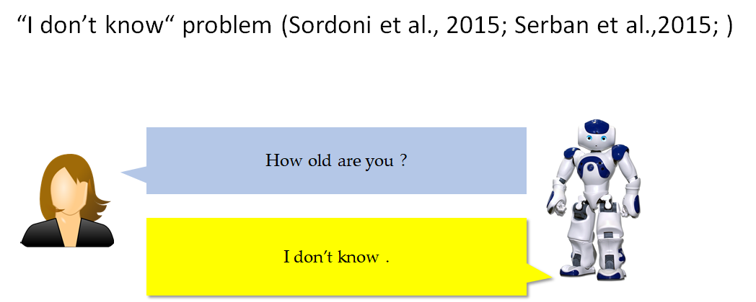
Mutual Information for Response Generation.

Slide 6
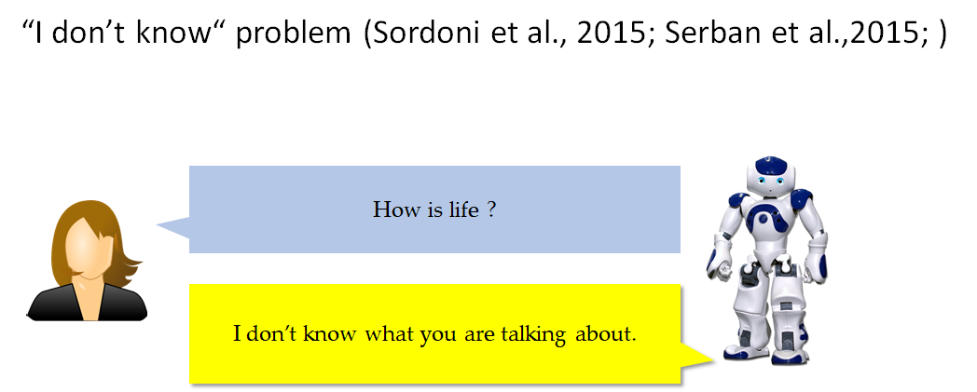
Mutual Information for Response Generation.

Slide 7
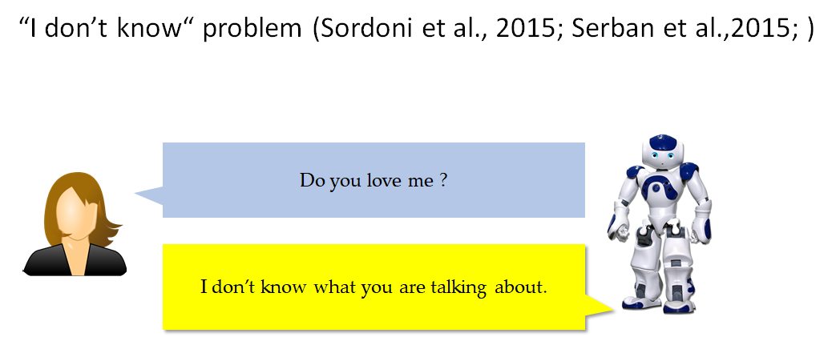
Mutual Information for Response Generation.

Slide 8
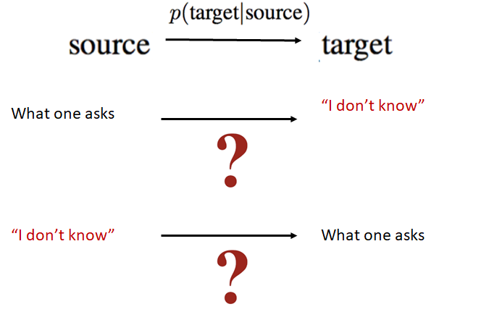
Mutual Information for Response Generation.

Slide 9
Mutual Information for Response Generation.

Slide 10
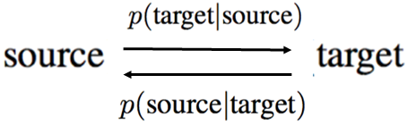
Mutual Information for Response Generation.

Slide 11
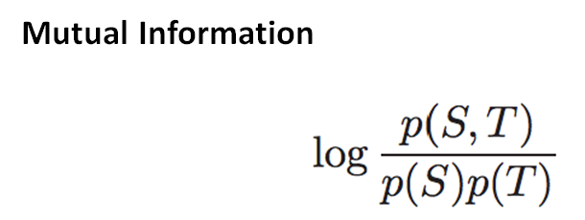
Mutual Information for Response Generation.

Slide 12
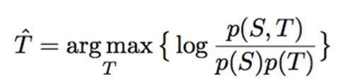


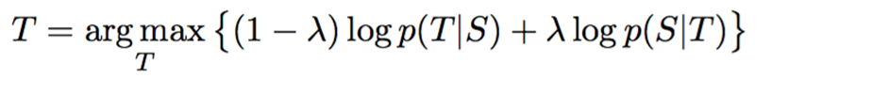
Mutual Information for Response Generation.

Slide 13


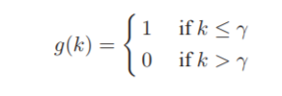
Problem: penalizes fluent responses

Slide 14
Problem: intractability
N-best lists given the first part of objective function, i.e., standard SEQ2SEQ model p(T|S). Then we rerank the N-best lists using the second term of the objective function

Slide 15
Evaluation
Datasets: Twitter conversational Dataset (23M pairs)
Opensubtitle movie scripts dataset (80M pairs)
Evaluations : BLEU (Papineni et al., 2003)
#Distinct tokens
Human Evaluation
(1000 samples, each output is evaluated by 7 judges)

Slide 16
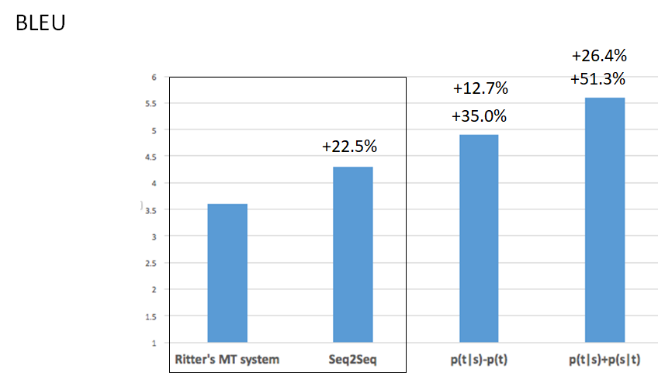

Slide 17
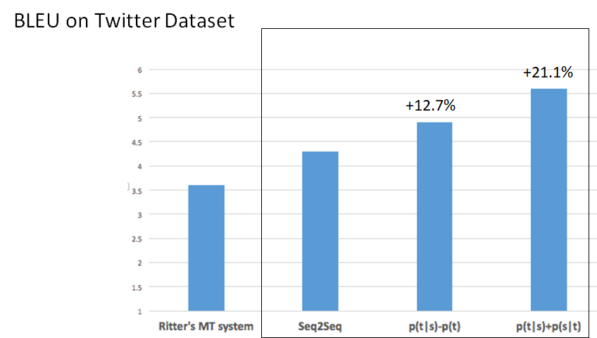

Slide 18
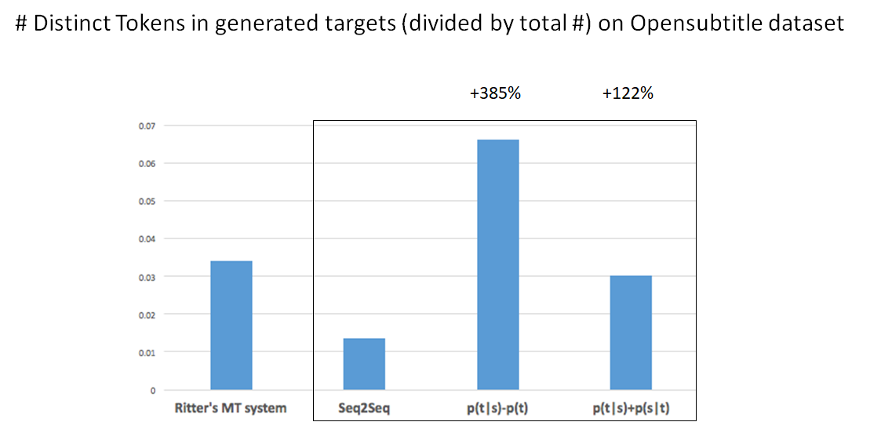

Slide 19
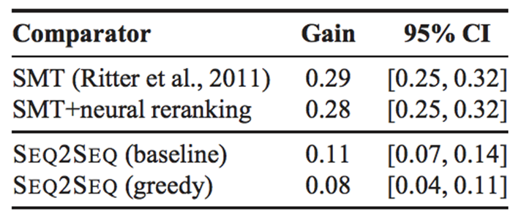
Human Evaluation

Slide 20
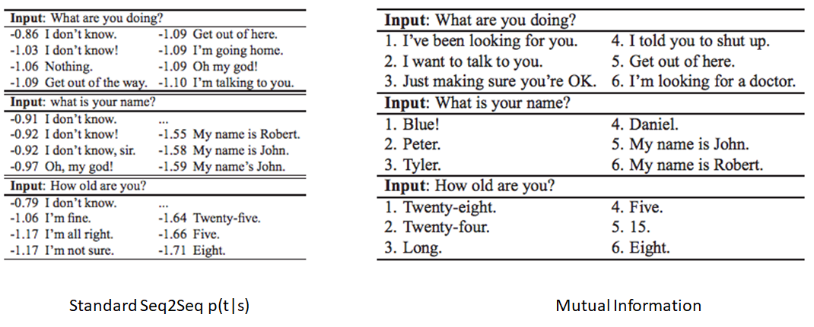
Sampled Results

